Slide 1


Team 8
DIG4104c
Fall 2016

Slide 2
DIG4104c - TEAM 8
Creation Team:
Alex Crocker
Maha Dafterdar (developer)
Judith Melendez
Editorial Team:
Pascal Parsard
John Flynn

Slide 3
CPYC BACKGROUND
California Police Youth Charities (CPYC) is a charity organization since 2002. Their mission is to build relationships between the law enforcement community and California youth. For many “at risk” adolescents CPYC means opportunities for scholarships and supporting of productive activities to keep them out of trouble.

Slide 4
CPYC SYNOPSIS
Market: Non-profit
current status : none available
Last tax information : 2014

Slide 5
MARKET ANALYSIS/COMPARABLES
CHARITY NAME | Location | OVERALL SCORE | FINANCIAL RATING
California Police Youth Charities (CA) | CA | 24.35 | 0
A Place Called Home | CA | 93.03 | 90.15
Boys and Girls Club | CA | 92.34 | 89.17
CASA of Los Angeles | CA | 81.19 | 73.71
Make A Wish Foundation | CA | 92.35 | 89.61

Slide 6
CPYC SYNOPSIS
Income Statement
REVENUE | AMOUNT
Total Contributions | $1,444,343
Total primary revenue | $1,444,343
other Revenue | $118
TOTAL REVENUE | $1,444,461
EXPENSES | AMOUNT
Program Expenses | $251,271
Administrative Expenses | $62,616
Fundraising Expenses | $1,436,518

Slide 7
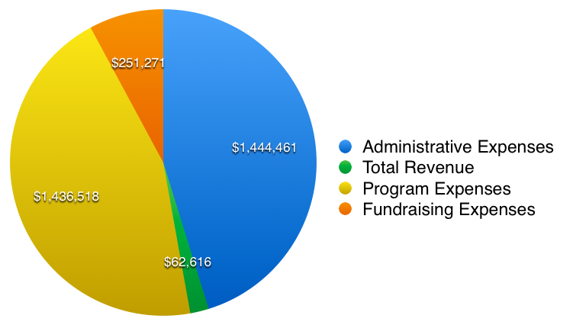
CPYC SYNOPSIS
Financial Chart

Slide 8
SITE ANALYSIS

Slide 9
SITE ANALYSIS
Confusing logo
Table-based layout
unresponsive
Inconsistent Navigation.
Missing call to action-
Single donate button
Outdated content
Broken links
Use of Flash banner at the top of the Home page
SEO issues

Slide 10

CONFUSING LOGO

Slide 11
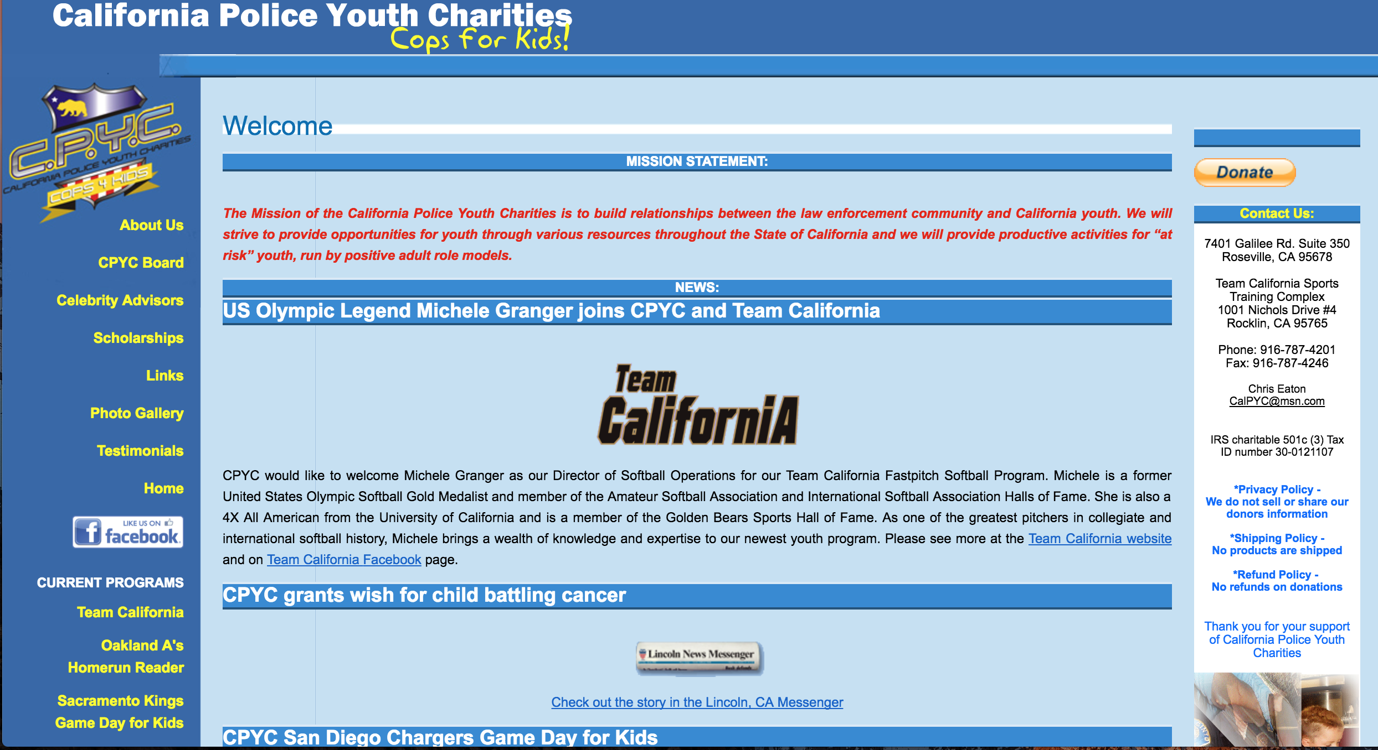
CURRENT CPYC WEBSITE

Slide 12
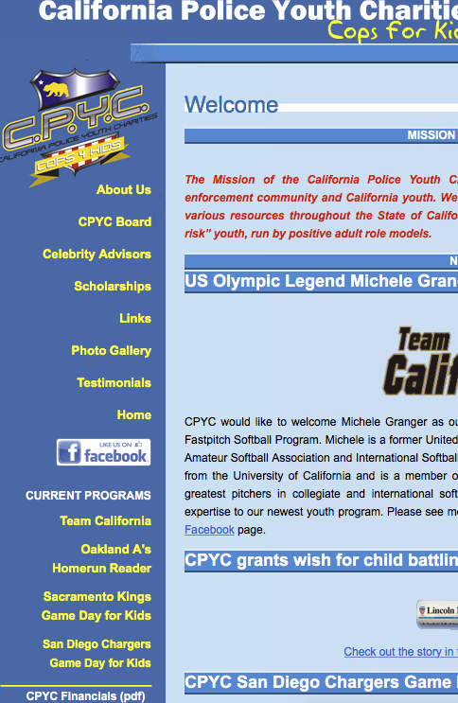
UNRESPONSIVE WEBDESIGN

Slide 13
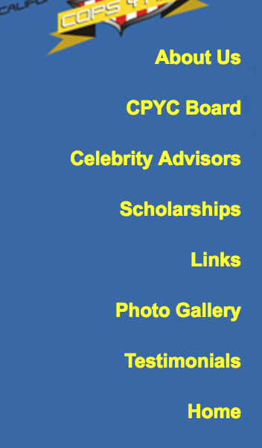
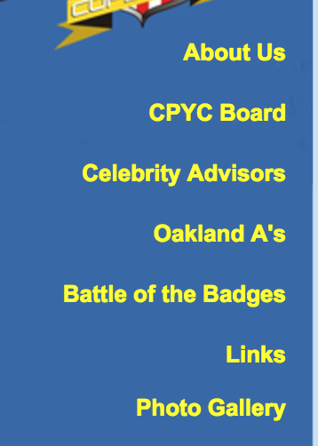
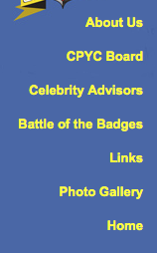
INCONSISTENT NAVIGATION
Home Page
About Page
Celebrity Page

Slide 14
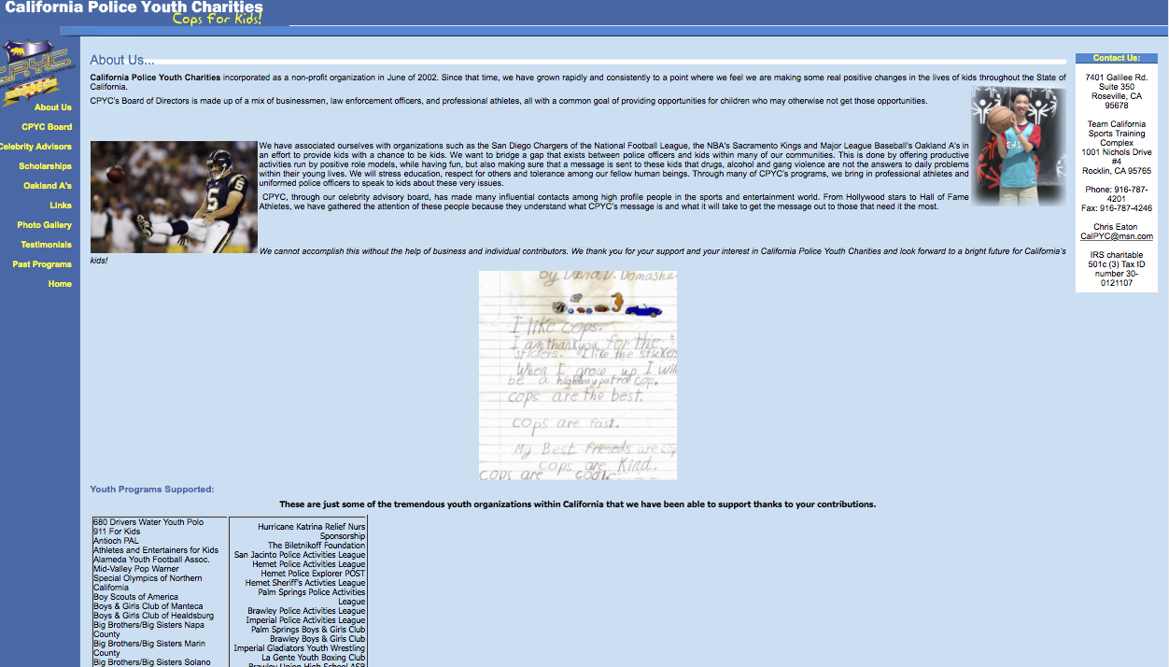
OUTDATED CONTENT

Slide 15
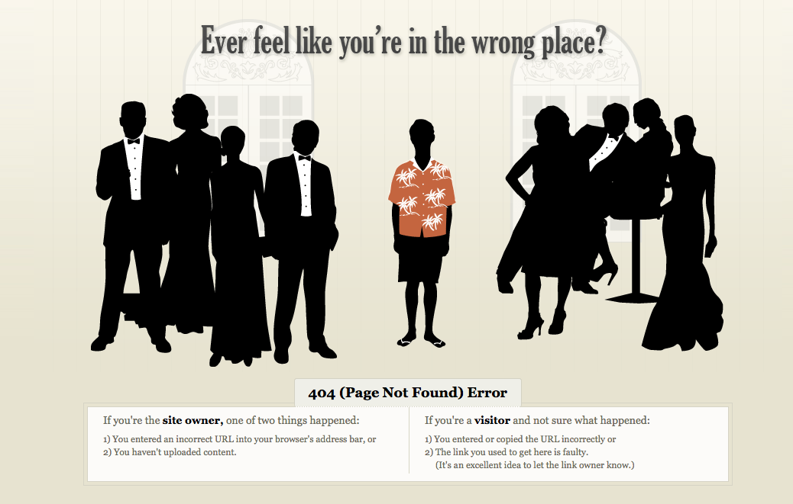
BROKEN LINKS
SITE ANALYSIS

Slide 16

USE OF FLASH BANNER / MISSING CALL TO ACTION

Slide 17
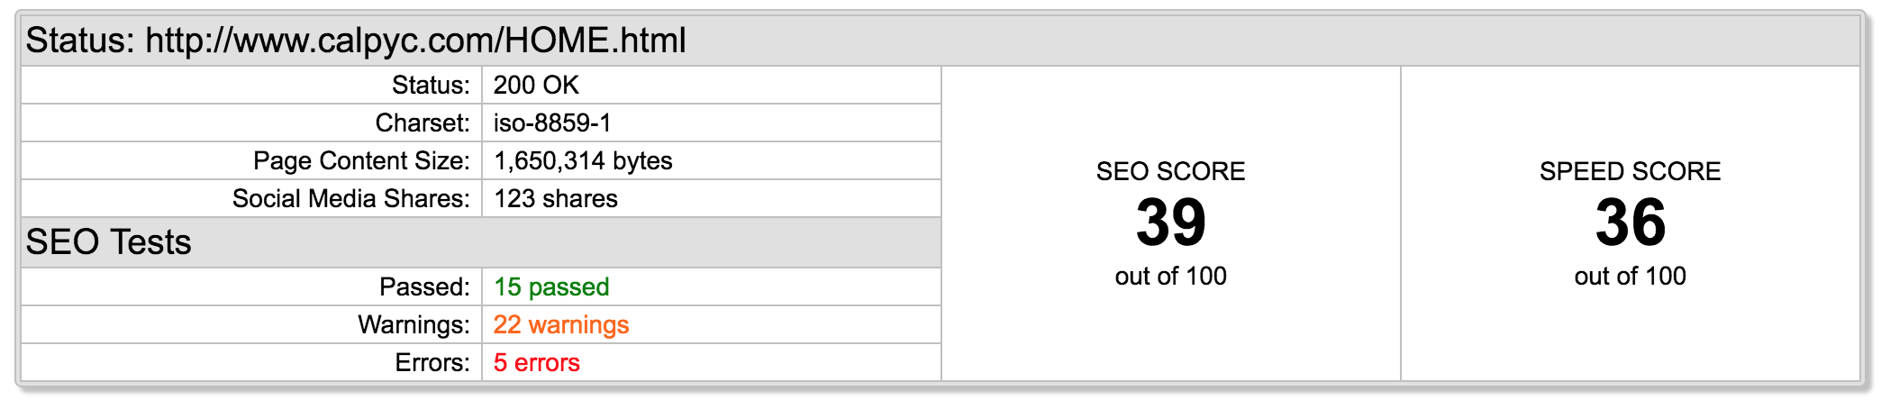
CHECKUP - SEO
No website description
No robots.txt
Some images don’t have alt attributes
No site map
3 heading tags are too long

Slide 18
FEATURE SELECTION

Slide 19
FEATURE SELECTION
Logo
A fresh and memorable design that immediately identify the charity brand
Clean and Responsive layout
An actual responsive Home Page that tells you about what CPYC is about
A consistent navigation menu in every page
Content/ About us
Pages have been re-arrange and content break down for a better user experience
More Focus on children and get rid of unrelated content
Under About Us We include submenus for Board members and Youth programs that CPYC support
New donate button
Visible donate buttons and call to action
Social Media
Integration of two additional social media networks and a peak of current social media postings
Programs and Events
Break down into 4 major categories
All text is tagged correctly and searchable
Events/links
Empty event page has been eliminated and link page for sponsors have been re-arrange in a orderly manner
SEO Errors 0

Slide 20

LOGO
From this
To this
The first thing we changed from the existing site is the logo. We knew it had to be simplified from the very beginning. CPYC was driving people away in droves due to inconsistent branding.
In the old logo, they have four different names. In the new logo, we radically simplified it by just going with the acronym CPYC and a silhouette of a man and child. A more recognizable logo

Slide 21
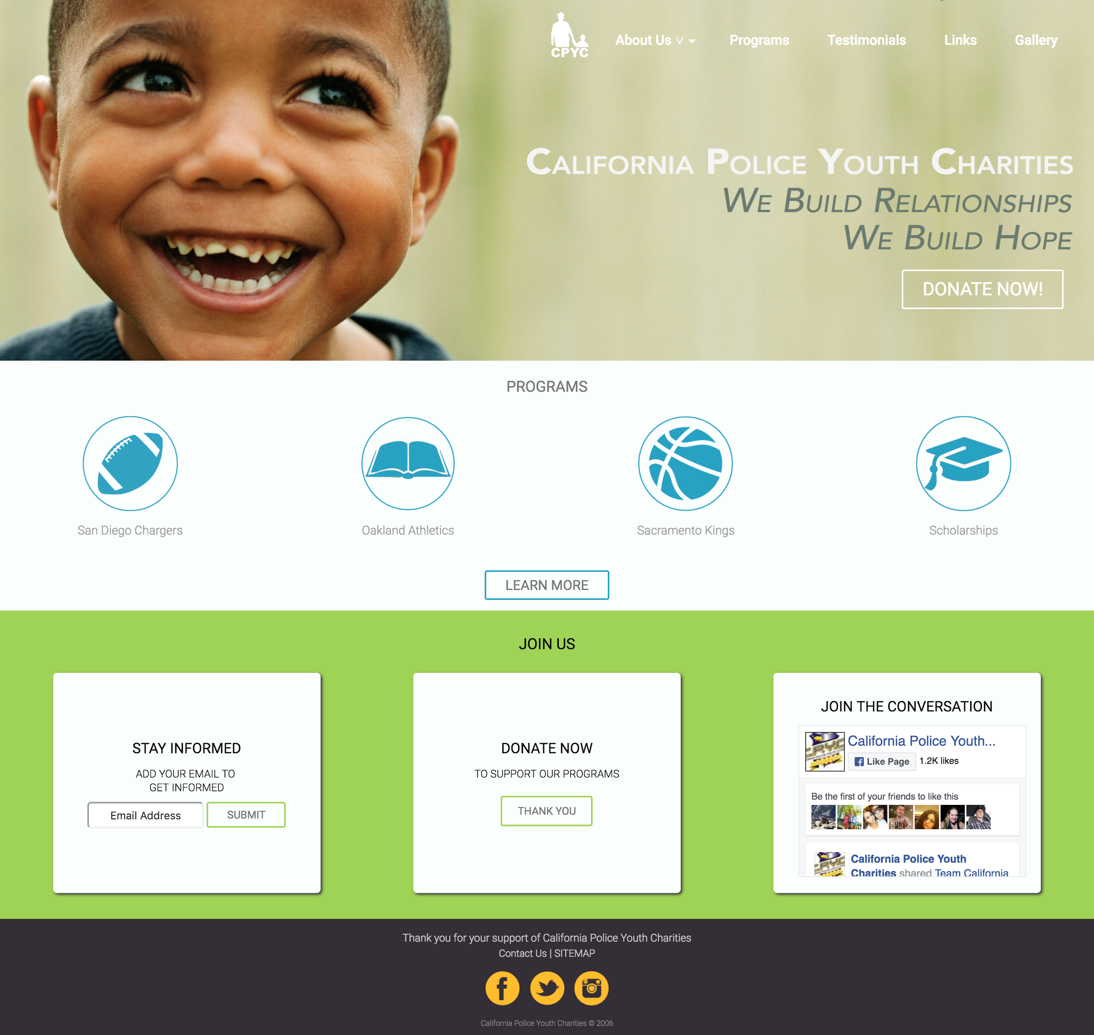
CLEAN AND FRIENDLY LAYOUT

Slide 22
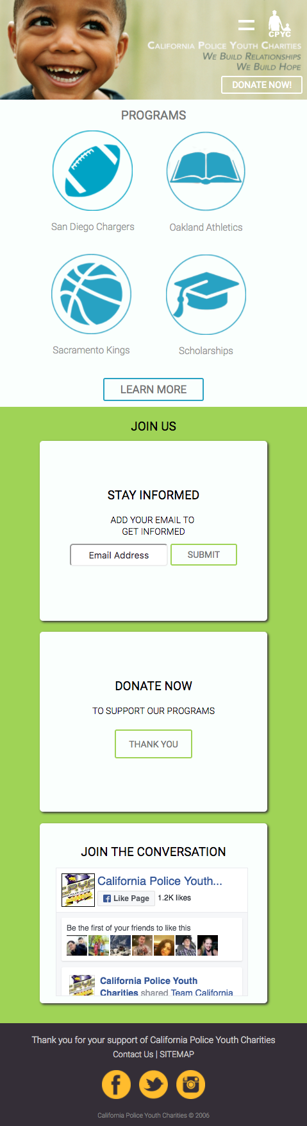
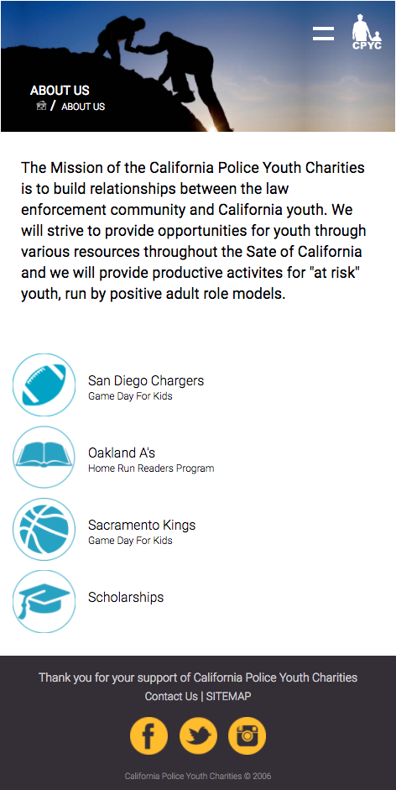
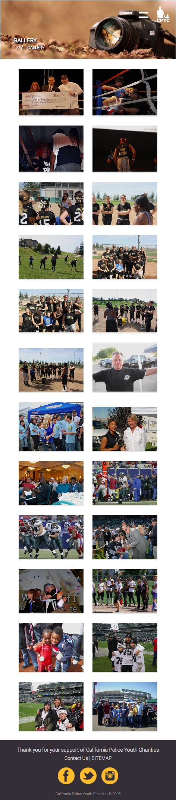
RESPONSIVE LAYOUT

Slide 23
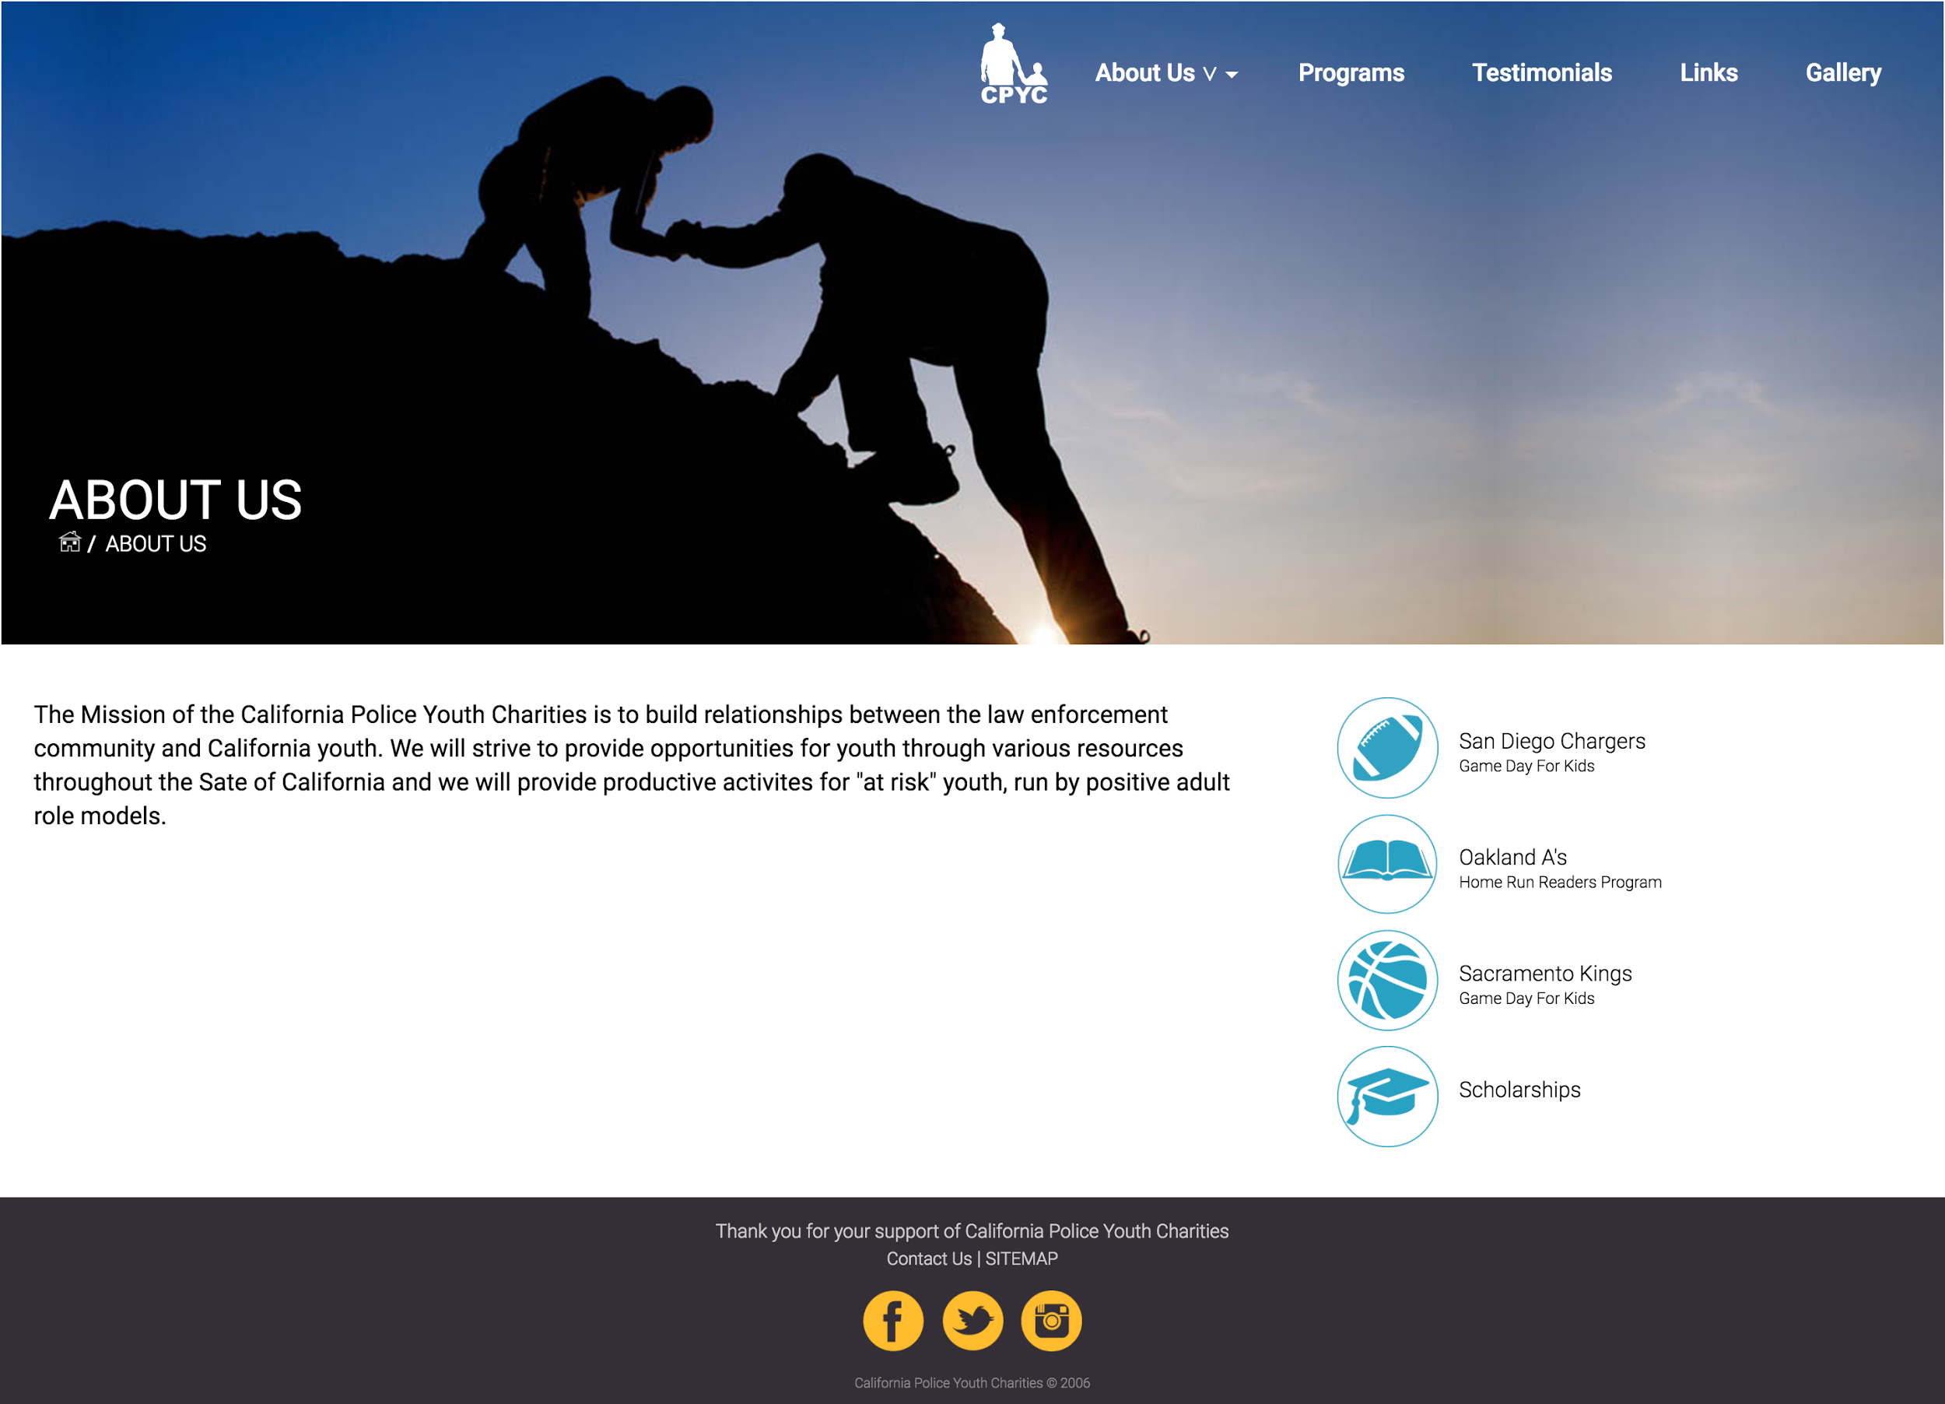
ABOUT US - CONTENT REARRANGED

Slide 24
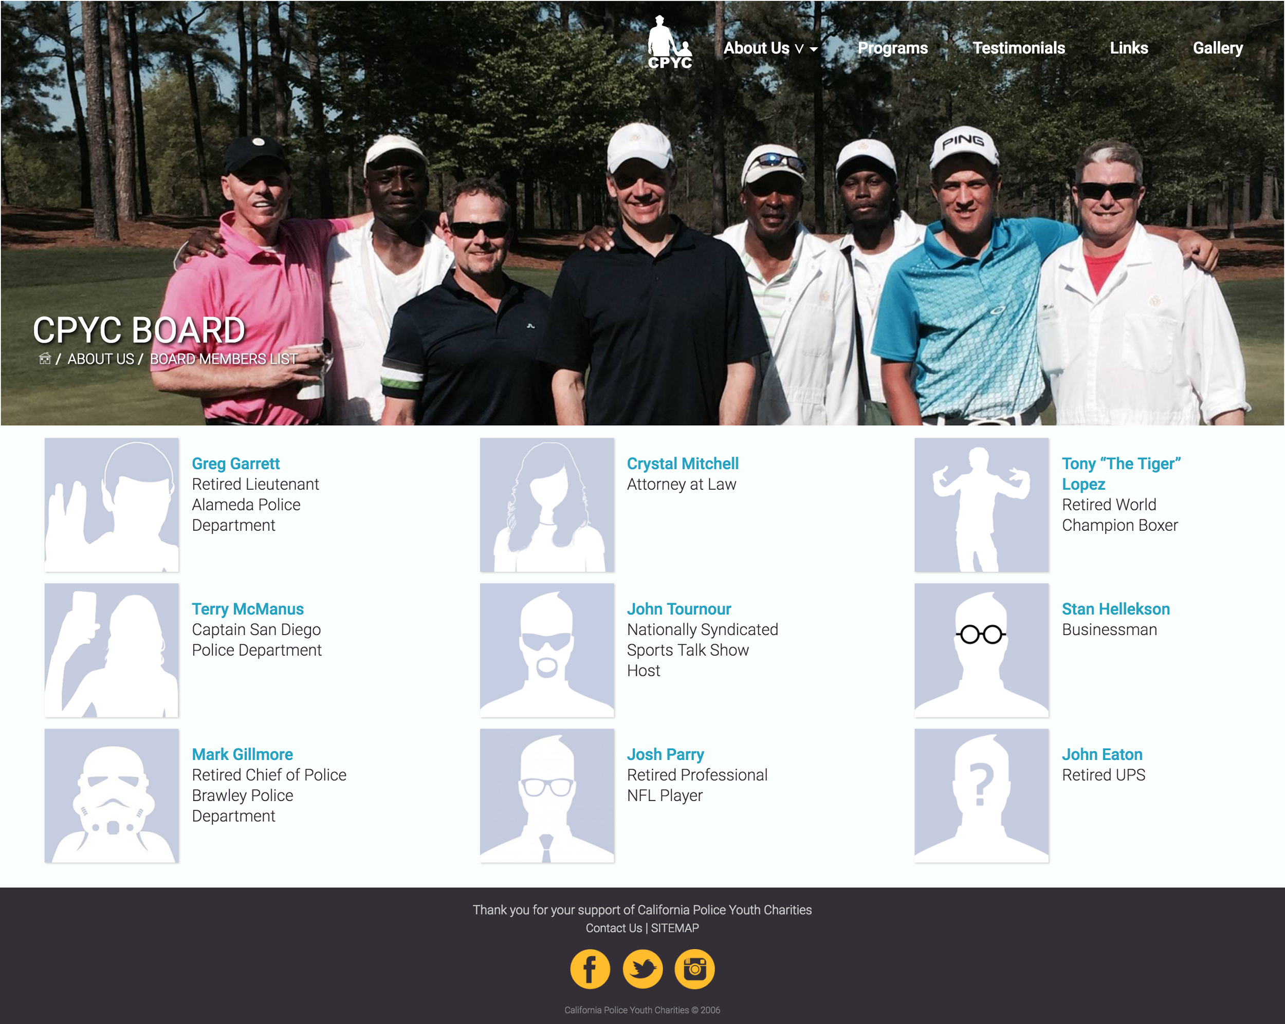

ABOUT US - BOARD/ YOUTH PROGRAMS SUBMENUS

Slide 25
USE OF FLASH BANNER
MISSING CALL TO ACTION
VS.
CLEAN LAYOUT
CALL TO ACTION

Slide 26

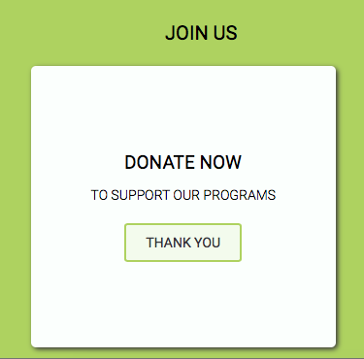
DONATE BUTTONS / CALL TO ACTION

Slide 27
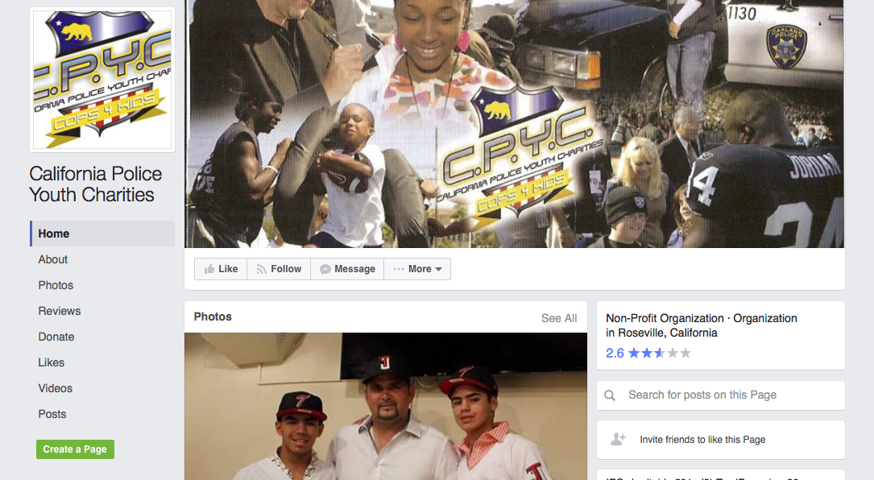



SOCIAL MEDIA INTEGRATION
Current Social Media
Feature Social Media

Slide 28
SOCIAL MEDIA - FEEDS

Slide 29

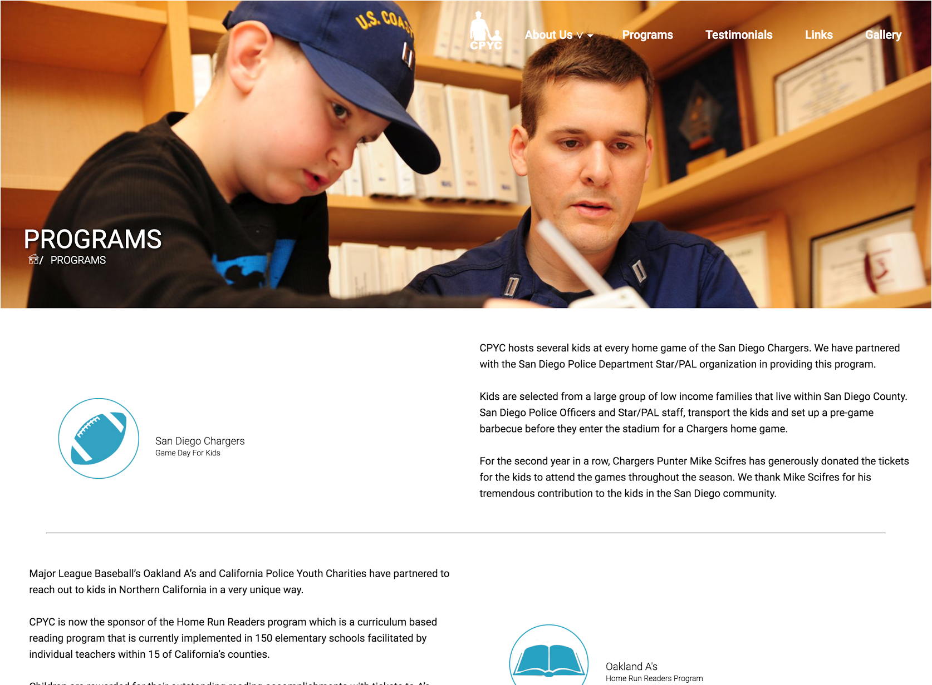
PROGRAMS /EVENTS

Slide 30
OPTIMIZED
website description
robots.txt
Images with alt attributes
New and improved site map
Heading tags are short and related to the content

Slide 31
DESIGN SUMMARY

Slide 32
DESIGN SUMMARY -TYPOGRAPHY
H1 HEADER :size: 24px / color: #fff
H2 HEADER : size: 24px / color: #342E37
H2 HEADER : size: 22px / color: 9fd356, #9fd356 , #28a2c3
H2 HEADER : size: 20px /color:#444444
H3 Header: size: 14px/ color: #342E37;
BUTTONS : size: 22px , 20px, 18px /color: #777777;
The font -family used for the text of the entire CPYC website was ROBOTO
Regular : content and text
Regular -Italic: call to action
Bold : for some headings
Bold-white : for CPYC logo

Slide 33






DESIGN SUMMARY - SITE COLOR PALLETTE
We wanted to change the original site’s blue color to a calmer green shade because blue is a popular color among charities already, so we feel CPYC has a better chance to stand out with a fresh color scheme that invite
#28a2c3
#9fd356
#e7bb41
#342d37
#fafffd

Slide 35

DESIGN SUMMARY- NEW LOGO

Slide 36
PROMOTION PLAN

Slide 37
SOCIAL MEDIA FEEDS/ INTEGRATION OF ADDITIONAL SOCIAL NETWORKS/ NEWSLETTER

Slide 38
TECHNOLOGY SELECTION PROCESS
Coding : HTML5 , CSS3, JavaScript
Responsive layout: Media-queries
Prototype and images :Photoshop, Illustrator.
Group communication: Slack

Slide 39
MAINTENANCE PLAN

Slide 40
Bronze ($66/hr/mo)
Changing or Removing images and graphics provided by you and ensure these are optimized for search engines
Adding of upto 2 pages including content and images provided by you.
SEO analysis : check up and recommendations to people who handle your website
Silver ($110/hr/mo)
Changing or Removing images and graphics provided by you and ensure these are optimized for search engines
Adding of upto 4 pages including content and images provided by you.
Content marketing review: check for relevant content according to your target market
SEO analysis : check up and recommendations to people who handle your website, plus Update of your meta tags
Social media review
Gold ($120/hr/mo)
Changing or Removing images and graphics provided by you ensure these are optimized for search engines
Adding of up to 5 pages including content and images provided by you.
Content marketing review and creation : check for relevant content according to your target market .
SEO analysis report :Thoroughly SEO check up from code to usability to achieve high rank on search pages
Social media strategy: strengthen your presence on social media and reach and engage with communities of people in the social network .

Slide 41
SUGGESTED MAINTENANCE PLAN AND UNIMPLEMENTED UPDATES
One of the most important qualities of a website is to make sure that it is attractive to new customers and keep the ones that already have.
An outdated information could impact negatively to the company brand. So keeping a website engaged and optimized is the best option to avoid losing such important investment.
Our convenient Silver package will make sure your site will run safe and uptodate.

Slide 42
SUCCESS
A new branding and color standards
A modern and stylish look with powerful images
Site responsive , adapted to mobile devices
More readable content
A more friendly user experience
Clear navigation with fewer options
Clear Donate button
Social media presence
Improved SEO

Slide 43
CHALLENGES
Prototyping and defining , shape , text and graphics with a more friendly user experience
A new branding and color standards definition
Make sure user experience is consistent within every page
Adapt top menu and scaling images to serve across multiple screens and platforms.
Content break down in small chunks and arranged in a more logical order
Search of powerful images to project the right emotions to any visitors
Integration of social media feed

Slide 44

Questions?

